Slide 1
Domain Modeling

Slide 2
What is domain modeling?
A domain model is a model of domain within which enterprise conducts its business.
Our first step in OOAD is understanding the domain in which system being developed or modified will operate.
The domain model is created in order to represent the vocabulary and key concepts of the problem domain.

Slide 3
Domain Modeling contd…
The domain model can be effectively used to verify and validate the understanding of the problem domain among various stakeholders.
It is especially helpful as a communication tool and a focusing point both amongst the different members of the business team as well as between the technical and business teams.

Slide 4
Domain Modeling contd…
An object model of the domain that incorporates both behavior and data.
In other words it is a description of
Classes or objects in the project’s problem domain called Domain Class modeling
Behavior relevant to the domain called Domain behavior modeling

Slide 5
Domain Modeling contd…
Domain Class Modeling
This will include classes with attributes & operations with various types of associations
Domain behavior Modeling
A type of diagram that depicts behavioral features of a system or business process.
This includes activity, state machine, and use case diagrams as well as the four interaction diagrams.
Interaction diagrams. A subset of behavior diagrams which emphasize object interactions. This includes communication, interaction overview, sequence, and timing diagrams

Slide 6
CASE STUDY

Slide 7
Case Study

Slide 8
Development Strategy

Slide 9
The NextGen POS System
A POS system is a computerized application used to record sales and handle payments; typically used in retail store.
It includes hardware components such as a computer and bar code scanner, and software to run that system.
It interfaces to various service applications, such as a third party tax calculator and inventory system.

Slide 10
Contd..
These systems must be relatively fault tolerant; i.e, even if remote services are temporarily unavailable (like inventory), they must still be capable of capturing sales and handling at least cash payments (business won’t be crippled).
A POS system increasing must support multiple and varied client-side terminals and interfaces. These includes a thin-client Web browser terminal, a regular personal computer with something like Java Swing Graphical user interfaces, touch screen input, wireless PDAs and so forth.

Slide 11
Contd..
Furthermore, we are creating a commercial POS system that we will sell to different clients with disparate needs in terms of business rules processing.
Each client will desire a unique set of logic to execute at certain predictable points in scenarios of using the system, such as when a new sale is initiated or a new line item is added. Therefore, we will need a mechanism to provide this flexibility and customization.

Slide 12
Contd..
Using a iterative development we are going to proceed through requirements, OOA,OOD and implementation.

Slide 13
Requirement Process

Slide 14
Requirement Processes
Requirement analysis may include stories or scenarios of how people use the application; these can be written as USE CASES
USE CASES are not object oriented artifacts- they are simply written stories
Software requirements engineering is the process of determining what is to be produced in a software system

Slide 15
UML Framework

Slide 16
System Requirements
System requirement consists of
Functional Requirements
What Systems do
Inputs, Outputs, Process
Non-Functional Requirements
Constraints on system
Performance, Volume, Security etc
Usability Requirements
User effectiveness, efficiency, comfort
=> Use Cases Primarily Model Functional Requirements
Notes:
2
Functional requirements
Inputs
Processing
Outputs
Persistent Data (what to store)
Non-Functional Requirements
Performance criteria
Availability (24/7 / office hours etc)
Volumes of data
Number of transactions
Size of stored data
Security
Who can access
Level of protection

Slide 17
Traditional Approach to requirements
Documentation detailing description of system
Document forms “contract” with client
Discussions focus upon document
Result:
Large legalistic documents
Easy to misinterpret
Changes hard to manage
Easy to miss / omit requirements
Modern approach – Model using UML
Use cases are used to capture functional requirements
Notes:
2

Slide 18
Use Case Modeling
Models the ‘actors’ outside a system and their interactions with that system
Every way that an ‘actor’ uses a system is called a Use Case
Model:
Desired functionality
Constraints on functionality
Hence build what client wants!
Notes:
2

Slide 19
Reasons for Use Cases
No information system exists in isolation
Most systems interact with humans or other automated systems (actors) that use the system for some purpose
Actors expect the system to behave in a predictable way
Use Cases specify the behavior of the system
Helps visualize the system
Notes:
2

Slide 20
Use Case Modelling
Use Case diagram
Diagram illustrating
Actors
Use cases
In the system
Use Case Description
Specification of what happens in each use case
Textural description
Diagrams

Slide 21
Example of a Use Case Diagram
Check status
Salesperson
Place order
Customer
Fill orders
Shipping Clerk
Establish credit
Supervisor
Notes:
11

Slide 22
Elements of Use Case Models
Use Case
Actor
Relationship
Use Case Diagram
Scenario
System Boundary
Use case description
Notes:
6

Slide 23
Use Case
A Use Case is an interaction between the system and a person or another system to achieve a result
A required “bit” of functionality
It yields an observable result of value to an actor (and hence a developer)
Typically named with a verb than a noun
“Do something to something”
Notes:
6

Slide 24
Actors
A coherent set of roles that users of Use Cases play when interacting with Use Cases
Roles not users or people
User may have more than one role
Smith
Notes:
6

Slide 25
Relationships
A semantic connection among elements
Used to show:
A function required by an actor
Relationships between actors
Relationships between use cases
Some people also use external relationships
Relationships between things that do not directly interact with the system
Notes:
6

Slide 26
Use Case Diagram
A diagram that shows a set of Use Cases and Actors and their relationships
Use Case diagrams address a user-centric view of a system
Show a required “bit” of functionality
Notes:
6

Slide 27
Scenario / System Boundary
Scenario
A single path through a Use Case
Use case is usually a collection of scenarios
Included as part of use case description
System Boundary
A high level indication of the domain
Limit to investigation
System
Part of system in focus
Notes:
6

Slide 28
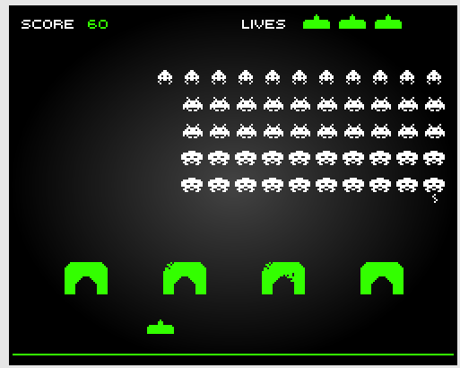
Exercise 1 – Use Case Diagram
In groups of 3-4 spend 5 minutes attempting to draw a use case diagram for the space invader game below:

Slide 29
Exercise 1 Solution

Slide 30
Relationships in use cases
Between actor and use case
Actor uses
Generalisation of actors
Types of users
Use case stereotypes
<<extend>>
Optional
<<include>>
Mandatory
Stereotype is a UML extension mechanism to indicate a type of behaviour

Slide 31
Generalisation of Actors
Blackboard Gradebook

Slide 32
Use case variants : include and extend
include relationship occurs when you have a chunk of behavior that is similar across more than one Use Case
use in two or more separate Use Cases to avoid repetition
a significant part of a use case
<<include>>
extend relationship where you have one Use Case which adds functionality to another Use Case
any Use Case can have more than one extend
use when describing a variation on or in addition to normal behavior
OPTIONAL BEHAVIOUR
Otherwise part of use case or
<<include>>
<<extend>>
Notes:
13

Slide 33
Example of Use Case Variants
Additional functionality
Place order
<<extend>>
Open account
Extension Point
Place back order
Place back order
<<include>>
<<include>>
<<include>>
Supply
Customer Data
Arrange delivery
shared functionality
Notes:
14

Slide 34
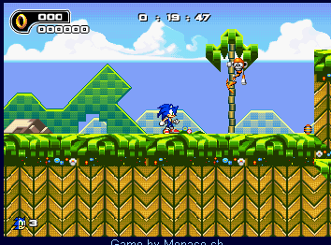
Exercise 2
Consider Sonic Game
What can sonic do?
What are the use cases?
Are there any relationships
Draw the use case diagram
Move left
Move right
Jump
Jump left
Jump right
Spin Dash
Pause
http://www.ebaumsworld.com/games/play/1108/

Slide 35
Exercise 2 – Possible Solution
Sonic Game
What about:
New game
Choose character
etc

Slide 36
Object Oriented Development Cycle

Slide 37
Software development
Analysis, design, implementation, testing & refinement to transform users’ need into software solution that satisfies those needs
Object-oriented approach
more rigorous process to do things right
more time spent on gathering requirements, developing requirements model & analysis model, then turn into design model
need not see code until after 25% development time

Slide 38
Software development process
Process to change, refine, transform & add to existing product
transformation 1(analysis) - translates user’s need into system’s requirements & responsibilities
how they use system can give insight into requirements, eg: analyzing payroll - capacity must be included in requirements

Slide 39
Software development process contd…
transformation 2 (design) - begins with problem statement, ends with detailed design that can be transformed into operational system
bulk of development activity, include definition on how to build software, its development, its testing, design description + prg + testing material

Slide 40
Software development process contd…
transformation 3 (implementation) - refines detailed design into system deployment that will satisfy users’ needs
takes account of equipment, procedures, resources, people, etc - how to embed software product within its operational environment, eg: new compensation method prg needs new form, gives new report.

Slide 41
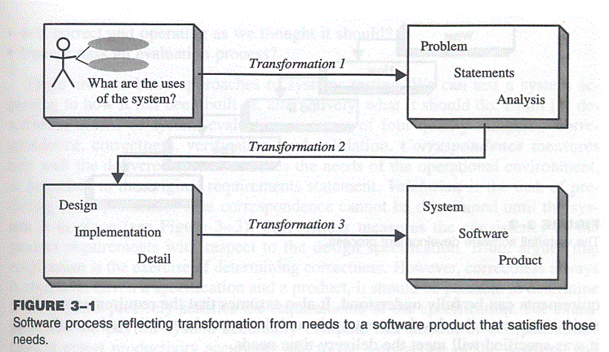
Software process – transforming needs to software product

Slide 42
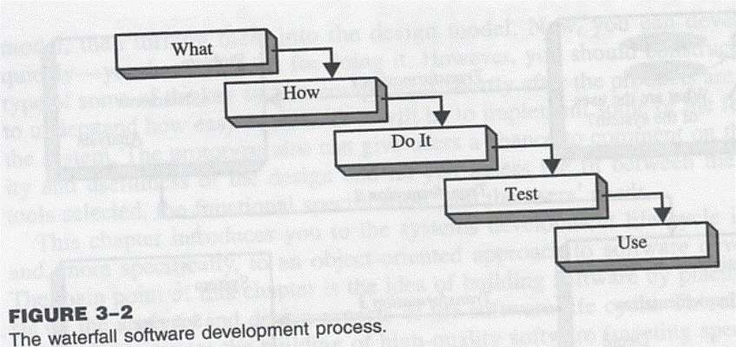
Waterfall Model – from ‘what’ to ‘use’

Slide 43
Why waterfall model fails
When there is uncertainity regarding what’s required or how it can be built
Assumes requirements are known before design begins
sometimes needs experience with product before requirements can be fully understood
Assumes requirements remain static over development cycle
product delivered meets delivery-time needs
Assumes sufficient design knowledge to build product
best for well-understood product
inable to cater software special properties or partially understood issues
doesn’t emphasize or encourage software reuse
Problem if environment changes
request changes in programs

Slide 44
Building high quality software
Goal is user satisfaction
how do we determine system is ready for delivery
is it now an operational system that satisfies users’needs
is it correct and operating as we thought it should ?
Does it pass an evaluation process ?

Slide 45
Object-oriented approach: A use-case driven approach
Object-oriented software development life cycle consists of
Object-oriented analysis
Object-oriented design
Object-oriented implementation
Use-case model can be employed throughout most activities of software development
designs traceable across requirements, analysis, design, implementation & testing can be produced
all design decisions can be traced back directly to user requirements
usage scenarios can be test scenarios

Slide 46
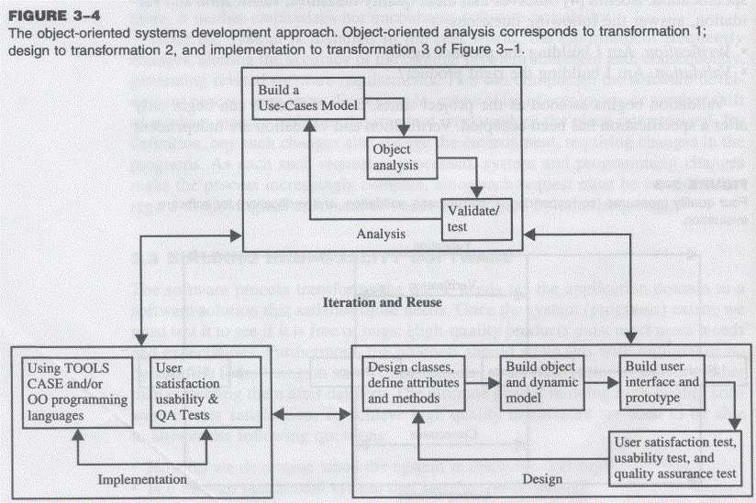
Object-oriented Systems Development Approach

Slide 47
Object-oriented software development
Activities
Object-oriented analysis - use case driven
Object-oriented design
Prototyping
Component-based development
Incremental testing
Encourages
viewing of system as a system of cooperative objects
incremental development

Slide 48
Object-oriented analysis - use-case driven
Use Case, is a name for a scenario to describe the user–computer system interaction.
Determine system requirements, identify classes & their relationship to other classes in domain
To understand system requirements
need to identify the users or actors
who are the actors ? How do they use system ?
Scenarios can help (in traditional development, it is treated informally, not fully documented)
Jacobson introduces concept of use case - scenario to describe user-computer system interaction

Slide 49
Use case
Typical interaction between user & system that captures users’ goal & needs
In simple usage, capture use case by talking to typical users, discussing various things they might want to do with system
can be used to examine who does what in interactions among objects, what role they play, intersection among objects’ role to achieve given goal is called collaboration
several scenarios (usual & unusual behaviour, exceptions) needed to understand all aspects of collaboration & all potential actions
use cased modeling
expressing high level processes & interactions with customers in a scenario & analyzing it
gives system uses, system responsibilities
developing use case is iterative
when use case model better understood & developed, start identifying classes & create their relationship

Slide 50
Identifying objects
What are physical objects in system ?
Individuals, organizations, machines, units of information, pictures, whatever makes up application/ make sense in context of real world
objects help establish workable system
work iteratively between use-case & object models
incentive payroll - employee, supervisor, office administrator, paycheck, product made, process used to make product
Documentation
80-20 rule
80% work can be done with 20% documentation
20% easily accessible, 80% available to few who needs to know
modeling & documentation inseparatable
good modeling implies good documentation

Slide 51
Object-oriented Design
Goal : to design classes identified during analysis phase & user interface
Identify additional objects & classes that support implementation of requirements
Eg. add objects for user interface to system (data entry windows, browse windows)
Can be intertwined with analysis phase
Highly incremental, eg. can start with object-oriented analysis, model it, create object-oriented design, then do some more of each again & again, gradually refining & completing models of system
Activities & focus of oo analysis & oo design are intertwined, grown not built

Slide 52
Object-oriented Design
First, build object model based on objects & relationship
Then iterate & refine model
Design & refine classes
Design & refine attributes
Design & refine methods
Design & refine structures
Design & refine associations

Slide 53
Guidelines in Object-oriented Design
Reuse rather than build new classes
Know existing classes
Design large number of simple classes rather than small number of complex classes
Design methods
Critique what has been proposed
Go back & refine classes

Slide 54
Prototyping
Prototype – version of software product developed in early stages of product’s life cycle for specific, experimental purposes
Enables us to fully understand how easy/difficult it will be to implement some features of system
Gives users chance to comment on usability & usefulness of user interface design
Can assess fit between software tools selected, functional specification & user needs
Can further define use cases, makes use case modeling easier
prototype that satisfies user + documentation -> define basic courses of action for use cases covered by prototype
Important to construct prototype of key system components shortly after products are selected
Pictures worth a thousand words
Build prototype with use-case modeling to design systems that users like & need

Slide 55
Prototyping: old & new
Before: prototype thrown away when industrial strength version developed
New trend: (eg. rapid application development) prototype refined into final product
Prototype used as means to test & refine user interface & increase usability of system
As underlying prototype design becomes more consistent with application requirements, more detail can be added to application
Test, evaluate & build further till all components work properly

Slide 56
Developing prototypes
Typical time from few days to few weeks
Should be done parallel with preparation of functional spec
Can result in modification of spec (some problems/features only obvious after prototype built)
Should involve representation from all user groups that will be affected by project
To ascertain all that the general structure of the prototype meets requirements established for overall design
Purpose of review
Demo that prototype has been developed according to spec & that final spec is appropriate
Collect info about errors & problems in systems, eg user interface problems
Give management & everyone connected with project glimpse of what technology can provide
Evaluation easier if supporting data readily available
Testing considerations must be incorporated in design & implementation of systems

Slide 57
Implementation: Component-based development
No more custom development, now assemble from prefabricated components
No more cars, computers, etc custom designed & built for each customer
Can produce large markets, low cost, high quality products
Cost & time reduced by building from pre-built, ready-tested components
Value & differentiation gained by rapid customization to targeted customers

Slide 58
Component-based development
Industrialized approach to system development, move form custom development to assembly of pre-built, pre-tested, reusable software components that operate with each other
Application development improved significantly if applications assembled quickly from prefabricated software components
Increasingly large collection of interpretable software components could be made available to developers in both general & specialist catalogs
Components themselves can be constructed from other components, down to prebuilt components/old-fashioned code written in prg languages like C
Visual tools/actual code can be used to glue together components
Visual glue – Digitalk’s Smalltalk PARTS, IBM VisualAge
Less development effort, faster, increase flexibility

Slide 59
Rapid Application Development
Set of tools & techniques to build application faster than typically possible with traditional methods
Often used with software prototyping
Iterational development
Implement design & user requirements incrementally with tools like Delphi, VisualAge, Visual Basic, or PowerBuilder
Begins when design completed
Do we actually understood problem (analysis) ?
Does the system do what it is supposed to do (design) ?
Make improvement in each iteration

Slide 60
Incremental testing
Software development and all of its activities including testing are an iterative process.
Waiting until after development waste money & time
Turning over applications to quality assurance group not helping since they are not included in initial plan

Slide 61
Reusability
Major benefit of Object-oriented approach
For objects to be reusable, much effort must be spent of designing it
Design reusability
Effectively evaluate existing software components
Has my problem been solved ?
Has my problem been partially solved ?
What has been done before to solve problem similar to this one ?
Need
detailed summary info about existing software components
Some kind of search mechanism
Define candidate object simply
Generate broadly/narrowly defined query

Slide 62
Reuse Strategy
Information hiding
Conformance to naming standards
Creation & administration of an object repository
Encouragement by strategic management of reuse as opposed to constant redevelopment
Establish target for % of object in project to be reuse

Slide 63
Overview of Unified Modeling Language: UML fundamentals & Notations

Slide 64
UML-Unified Modeling Language
UML → “Unified Modeling Language”
Language: express idea, not a methodology
Modeling: Describing a software system at a high level of abstraction
Unified: UML has become a world standard
Object Management Group (OMG): www.omg.org

Slide 65
UML-Unified Modeling Language contd…
visual language for specifying, constructing & documenting the artifacts of system
de facto standard diagramming notation or presenting pictures related to software

Slide 66
Ways to apply UML
There are three ways people apply UML.
They are:
UML as sketch
Informal and incomplete diagrams created to explore difficult parts of the problem or solution space, exploiting the power of visual language

Slide 67
Contd..
2. UML as blueprint
Relatively detailed design diagrams used either for reverse engineering to visualize and better understanding existing code in UML diagrams or for code generation (forward engineering)
3. UML as programming language
Complete executable specification of a software system in UML
Executable code will be automatically generated

Slide 68
Contd…
Agile Modeling
Emphasizes UML as sketch; this is a common way to apply the UML, often with a high return on investment of time
UML tools are/can be useful but still agile modeling approach to applying UML is encouraged

Slide 69
Three perspective to apply UML
UML describes raw diagram types, such as class diagrams & sequence diagrams & same UML can be used to draw pictures of concepts of software classes in Java.
i.e. the same notation is used for three perspectives & types of models.

Slide 70
Contd…
Conceptual perspective- the diagrams are interpreted as describing things in a situation of the real world or domain of interest.
Specification(software) perspective- the diagrams (using the same notation as in the conceptual perspective) describe software abstraction or components with specification and interfaces, but no commitment to particular implementation( for example, not specially a class in C# or Java)
Implementation (software) perspective- the diagram describe software implementations in a particular language (such as Java).

Slide 71
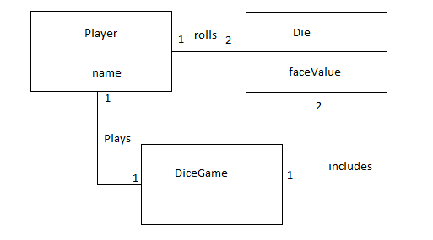
Fig-Conceptual Perspective

Slide 72
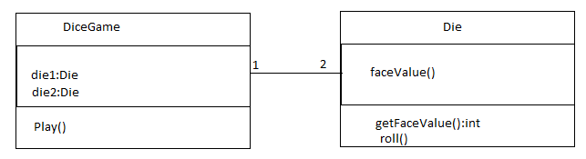
Fig – Specification Perspective

Slide 73
UML Diagrams
UML can be used to construct nine different diagrams to capture different views of the system

Slide 74
UML Diagrams
The nine different UML diagrams are:
Class Diagram
Object Diagram
Use Case Diagram
Sequence Diagram
Collaboration Diagram
Statechart Diagram
Activity Diagram
Component Diagram
Deployment Diagram

Slide 75
UML Views
The different views are
Structural
Behavioral
Implementation
Environmental as shown in the figure below

Slide 76
Contd...
Structural
View
Implementation
View
Class Diagrams
Object Diagrams
Component Diagrams
User View
Use Case
Diagrams
Sequence Diagrams
Collaboration Diagrams
Statechart Diagrams
Activity Diagrams
Deployment Diagrams
Behavioral
View
Environment
View

Slide 77
More on diagrams….
Class Diagram - the most common diagram found in OOAD, shows a set of classes, interfaces, collaborations and their relationships. Models the static view of the system.
Object Diagram - a snapshot of a class diagram; models the instances of things contained in a class diagram.
Use Case Diagram - shows a set of “Use Cases” (sets of functionality performed by the system), the “actors” (typically, people/systems that interact with this system[problem-domain]) and their relationships. Models WHAT the system is expected to do.

Slide 78
More on diagrams….
Sequence Diagram - models the flow of control by time-ordering; depicts the interaction between various objects by of messages passed, with a temporal dimension to it.
Collaboration Diagram - models the interaction between objects, without the temporal dimension; merely depicts the messages passed between objects.
Statechart Diagram - shows the different state machines and the events that leads to each of these state machines. Statechart diagrams show the flow of control from state to state.

Slide 79
More on diagrams….
Activity Diagram - shows the flow from activity to activity; an “activity” is an ongoing non-atomic execution within a state machine.
Component Diagram - shows the physical packaging of software in terms of components and the dependencies between them.
Deployment Diagram - shows the configuration of the processing nodes at run-time and the components that live on them.

Slide 80
UML Class Diagrams
Class diagram describes
Types of objects in the system
Static relationships among them
Two principal kinds of static relationships
Associations between classes
Subtype relationships between classes
Class descriptions show
Attributes
Operations
Class diagrams can also show constraints on associations

Slide 81
Example Class Diagram
Order
Customer
dateReceived
isPrepaid
number: String
price: Money
1..*
1
name
address
creditRating():String
dispatch()
close()
Constraint
for order class
indicates
generalization
1
Corporate
Customer
Personal
Customer
{ if Order.customer.creditRating() = “poor”
then Order.isPrepaid = true }
creditCardNumber
contactName
creditRating
creditLimit
Ordered
Product
1..*
remind()
billForMonth(Int)
Product Order
{creditRating()=“poor”}
quantity: Int
price: Money
isSatisfied: Bool
1..*
1
1..*
indicates that credit
rating is always
set to poor for a
Personal Customer
Product
Sales
Rep
0..1
Employee

Slide 82
Sequence Diagrams
A sequence diagram shows a particular sequence of messages exchanged between a number of objects
Sequence diagrams also show behavior by showing the ordering of message exchange
A sequence diagram shows some particular communication sequences in some run of the system
it is not characterizing all possible runs

Slide 83
A First Look at Sequence Diagrams
Illustrates how objects interacts with each other.
Emphasizes time ordering of messages.
Can model simple sequential flow, branching, iteration, recursion and concurrency.

Slide 84
A Sequence Diagram
member: LibraryMember
book:Book
:Book Copy
borrow(book)
ok = mayBorrow()
[ok] borrow(member)
setTaken(member)

Slide 85
A Sequence Diagram
X-Axis (objects)
member: LibraryMember
book:Book
:Book Copy
borrow(book)
Object
Life Line
Y-Axis (time)
ok = mayBorrow()
message
Activation box
[ok] borrow(member)
setTaken(member)
condition

Slide 86
Object
Object naming:
syntax: [instanceName][:className]
Name classes consistently with your class diagram (same classes).
Include instance names when objects are referred to in messages or when several objects of the same type exist in the diagram.
The Life-Line represents the object’s life during the interaction
myBirthdy :Date

Slide 87
Messages
An interaction between two objects is performed as a message sent from one object to another (simple operation call, Signaling, RPC)
If object obj₁ sends a message to another object obj₂ some link must exist between those two objects (dependency, same objects)

Slide 88
Messages (Cont.)
A message is represented by an arrow between the life lines of two objects.
Self calls are also allowed
The time required by the receiver object to process the message is denoted by an activation-box.
A message is labeled at minimum with the message name.
Arguments and control information (conditions, iteration) may be included.

Slide 89
Return Values
Optionally indicated using a dashed arrow with a label indicating the return value.
Don’t model a return value when it is obvious what is being returned, e.g. getTotal()
Model a return value only when you need to refer to it elsewhere, e.g. as a parameter passed in another message.
Prefer modeling return values as part of a method invocation, e.g. ok = isValid()

Slide 90
Synchronous Messages
Nested flow of control, typically implemented as an operation call.
The routine that handles the message is completed before the caller resumes execution.
:A
:B
doYouUnderstand()
return (optional)
Caller Blocked
yes

Slide 91
Object Creation
An object may create another object via a <<create>> message.
Preferred
:A
:B
:A
<<create>>
<<create>>
:B
Constructor

Slide 92
Object Destruction
An object may destroy another object via a <<destroy>> message.
An object may destroy itself.
Avoid modeling object destruction unless memory management is critical.
:A
:B
<<destroy>>

Slide 93
Control information
Condition
syntax: ‘[‘ expression ’]’ message-label
The message is sent only if the condition is true
example:
Iteration
syntax: * [ ‘[‘ expression ‘]’ ] message-label
The message is sent many times to possibly multiple receiver objects.
[ok] borrow(member)

Slide 94
Control Information (Cont.)
Iteration examples:
:CompoundShape
:Shape
:Driver
:Bus
draw()
*draw()
*[until full] insert()
The syntax of expressions is not a standard

Slide 95
Control Information (Cont.)
The control mechanisms of sequence diagrams suffice only for modeling simple alternatives.
Consider drawing several diagrams for modeling complex scenarios.
Don’t use sequence diagrams for detailed modeling of algorithms (this is better done using activity diagrams, pseudo-code or state-charts).

Slide 96
Example Sequence Diagram
:OrderEntryWindow
:Order
:ProductOrder
:StockItem
prepare()
*prepare()
check()
[check=“true”]
remove()
needsToReorder()
[needsToReorder=“true”]
<<create>>
:ReorderItem
[check=“true”]
<<create>>
:DeliveryItem

Slide 97
Collaboration (Communication) Diagrams
Collaboration diagrams (aka Communication diagrams) show a particular sequence of messages exchanged between a number of objects
this is what sequence diagrams do too!
Use sequence diagrams to model flows of control by time ordering
sequence diagrams can be better for demonstrating the ordering of the messages
sequence diagrams are not suitable for complex iteration and branching
Use collaboration diagrams to model flows of control by organization
collaboration diagrams are good at showing the static connections among the objects while demonstrating a particular sequence of messages at the same time

Slide 98
Corresponding Collaboration Diagram
Sequence numbers are used
to show the time ordering among
the messages
object
:OrderEntryWindow
1:prepare()
message
link
sequence number
:Order
1.1:*prepare()
1.1.2.1:needsToReorder()
:ProductOrder
:StockItem
1.1.1:check()
1.1.2:[check==true]remove()
1.1.2.2:new
1.1.3:[check==true]new
:DeliveryItem
:ReorderItem

Slide 99
State Diagrams
State diagrams are used to show possible states a single object can get into
shows states of an object
How object changes state in response to events
shows transitions between states
Uses the same basic ideas from statecharts and adds some extra concepts such as internal transitions, deferred events etc.
“A Visual Formalism for Complex Systems,” David Harel, Science of Computer Programming, 1987
Statecharts are basically hierarchical state machines
Statecharts have formal semantics

Slide 100
State Diagrams
Hierarchical grouping of states
composite states are formed by grouping other states
A composite state has a set of sub-states
Concurrent composite states can be used to express concurrency
When the system is in a concurrent composite state, it is in all of its substates at the same time
When the system is in a normal (non-concurrrent) composite state, it is in only one of its substates
If a state has no substates it is an atomic state
Synchronization and communication between different parts of the system is achieved using events

Slide 101
State Diagrams: Superstates
Active is a superstate
with substates Checking,
Waiting and Dispatching
/ getFirstItem
Active
getNextItem
[not all items checked]
Checking
[all items checked and
all items available]
Dispatching
do/checkItem
do/initiate
Delivery
itemReceived
[all items available]
[all items checked and
some items not in stock]
itemsReceived
[some items not in stock]
Waiting
cancelled
Cancelled
Delivered

Slide 102
State Diagrams: Concurrent States
cancelled
Waiting
Cancelled
Checking
Dispatching
Delivered
Authorizing
Authorized
this transition
can only be taken
after both concurrent
states reach their
final states
[payment not OK]
Rejected

Slide 103
Activity Diagrams
Activity diagrams show the flow among activities and actions associated with a given object using:
activity and actions
transitions
branches
merges
forks
joins
Activity diagrams are similar to SDL state diagrams, SDL state diagrams have formal semantics
Activity diagrams are basically an advanced version of flowcharts

Slide 104
Finance
Order
Processing
Stock
Manager
Receive Order
ReceiveSupply
*for each
order item
Choose Outstanding Order Items
Authorize Payment
Check Order
Item
vertical lines
are used to separate
“swimlanes”
to show which
activities are handled
by which part of the
system
* for each
chosen
order item
[in stock]
[failed]
Assign to Order
Assign to Order
[succeeded]
Cancel Order
[need to reorder]
Reorder
item
[all outstanding order
items filled]
[stock assigned to all order items
and payment authorized]
Add Remainder
to Stock
Dispatch
Order

